Slide 1

Setting up your goal
Satisficing and
optimizing metrics
deeplearning.ai

Slide 2
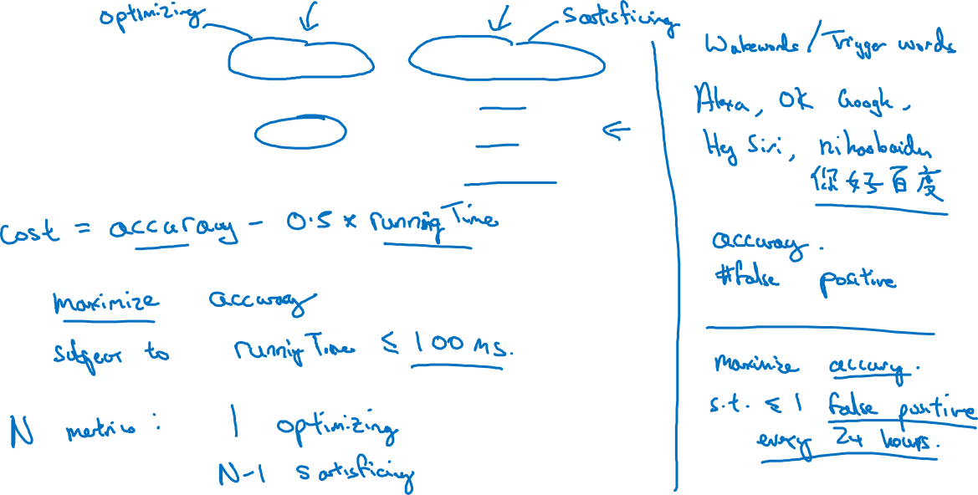
Another cat classification example
Classifier | Accuracy | Running time
A | 90% | 80ms
B | 92% | 95ms
C | 95% | 1,500ms
A condition

